Slide 1
IBM Planning Analytics

Slide 2



What Is IBM Planning Analytics
IBM Planning Analytics, verimliliği artırmanıza, öngörü sağlamanıza ve iş performansını arttırmanıza yardımcı olan hızlı, kolay, esnek ve eksiksiz planlama yapma imkanı sağlayan bir çözümdür
Steer continuously
Deliver foresight
Drive efficiency

Slide 3
IBM Planning Analytics – 3 Themes
Sürekli değişen iş koşullarına hızlı bir şekilde uyum sağlayan, operasyonlar ve finans arasında köprü oluşturan, işletmeye ait, esnek çözümler
Çeviklik
Öngörü
Gelecek tahminlemesi , KPI ların belirlenmesi , farklı senaryolarla karşılaştırma yapma imkanı , trendlerin belirlenmesi
Son kullanıcıların benimseyeceği zaman ve iş gücünden tasarruf sağlayacak otomatize edilmiş sistem kullanımı
Hız
Notes:
Elevator pitch – this is what you need to remember:
point out parallels to PM journey with drive efficiency, deliver foresight, and steer business performance.
Describe the 3 themes of Speed, Foresight and Agility

Slide 4
IBM Planning Analytics Capabilities
Key Message | KEY CAPABILITIES
 | Planning & Analytics Workspace Excel Integration TM1 Engine
 | Data Discovery Advanced Analysis Internal & External Data
 | Strategy Management Metrics and Drivers Management Reporting
SPEED
FORESIGHT
AGILITY

Slide 5
IBM Planning Analytics Capabilities
Key Message | KEY CAPABILITIES
 | Planning & Analytics Workspace Excel Integration TM1 Engine
 | Data Discovery Advanced Analysis Internal & External Data
 | Strategy Management Metrics and Drivers Management Reporting
SPEED
FORESIGHT
AGILITY

Slide 6




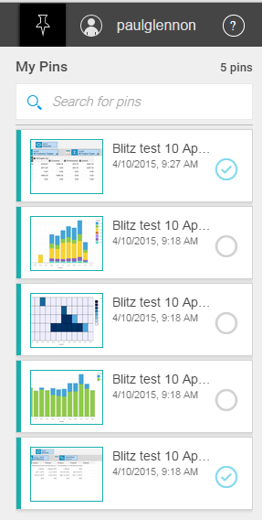
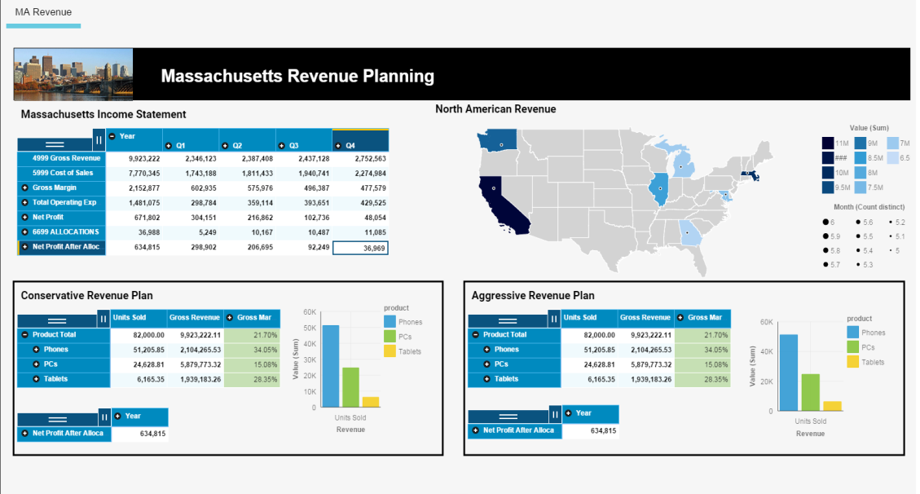

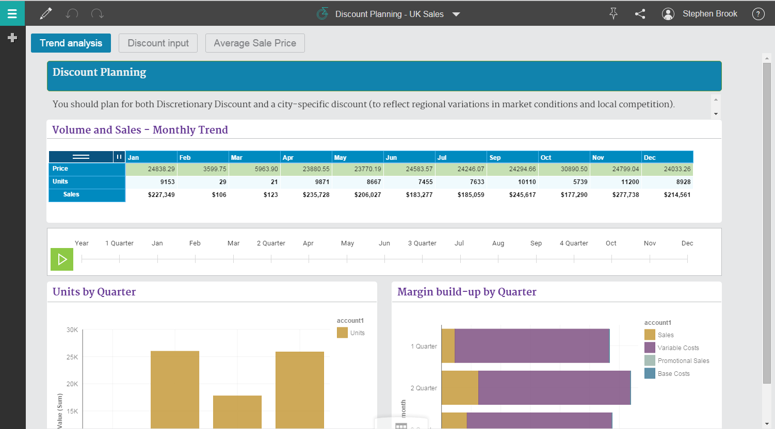
Planning Analytics Workspace
Best in Breed Planning | Easy, intuitive, graduated
Zengin çalışma alanı
Doğal dil işleme & manupilasyon
Yeniden kullanım , ekran paylaşımı , işbirliği yapma imkanı
Çok sekmeli çalışma alanları
Farklı veri kaynakları ile senkronizasyon

Slide 7
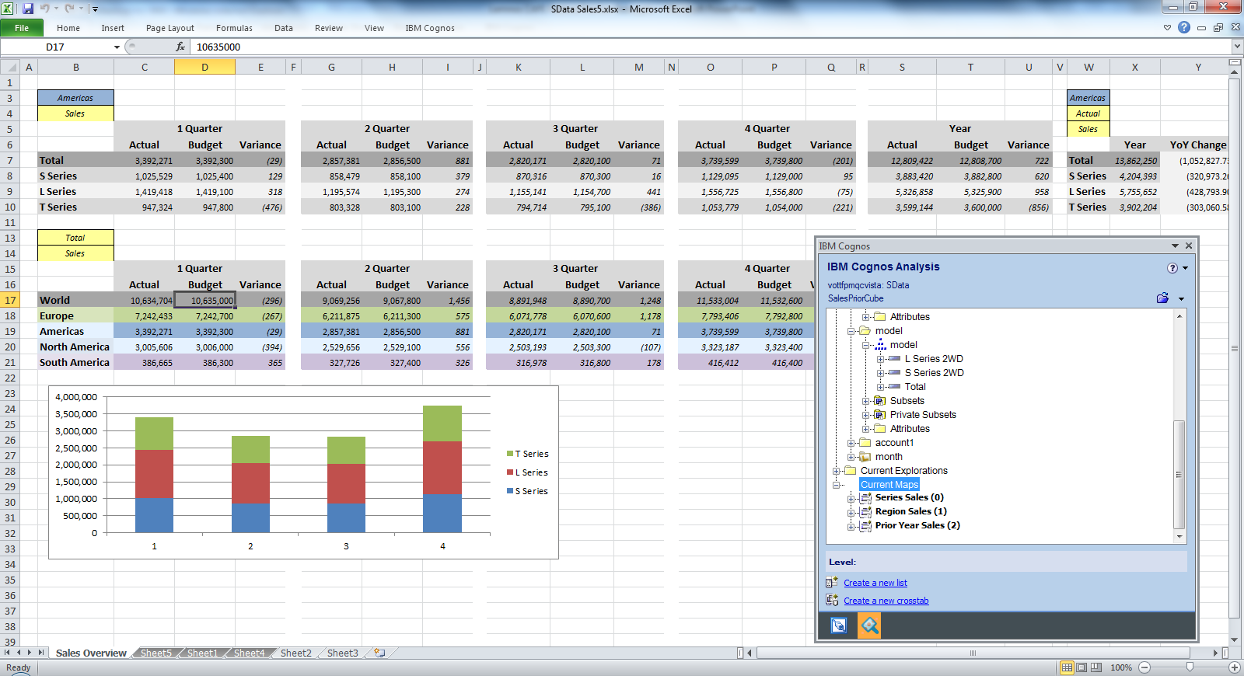
Robust Excel Integration
Embrace and Surround Excel
Planning Analytics Cloud ile Excel bağlantısı
Planning analytics ortamı ve excel arasında model bağlantısı

Slide 8







Hi-Speed, In-Memory Engine
Fast, Agile, Scalable
Even faster and more powerful than before
IBM Planning Analytics is the best Performance Management solution on the market for managing volatility, providing real-time responses to complex questions.
Fast Data Loading
Multi-Dimensional Analysis
Real Time
Flexible Model Definitions
Embracing Volatility
Forms Based Interface Design
High volume contribution
What-if analysis
Meta-data changes
Data refresh
Performance
Speed and Agility with new Smart Cache and Anti-Lock
Additional flexibility with attribute
analysis and hierarchies

Slide 9
IBM Planning Analytics Capabilities
Ana Mesaj | ANAHTAR ÖZELLİKLER
 | Planning & Analytics Workspace Excel Integration TM1 Engine
 | Veri Keşfi Gelişmiş Analiz Internal & External Veri
 | Strategy Management Metrics and Drivers Management Reporting
SPEED
Öngörü
AGILITY

Slide 10
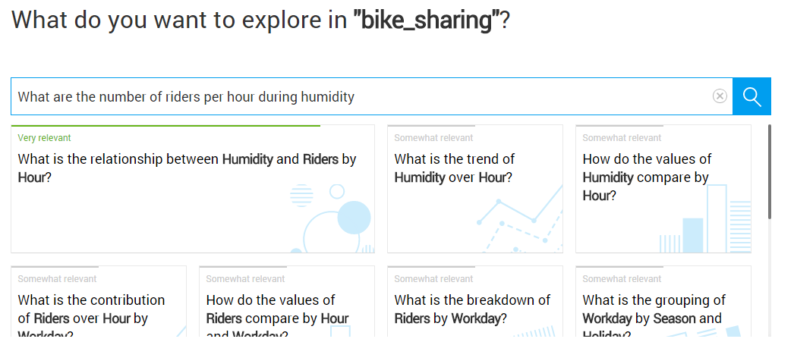
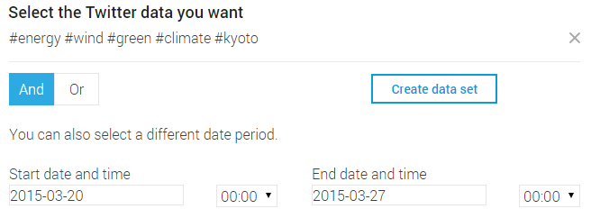

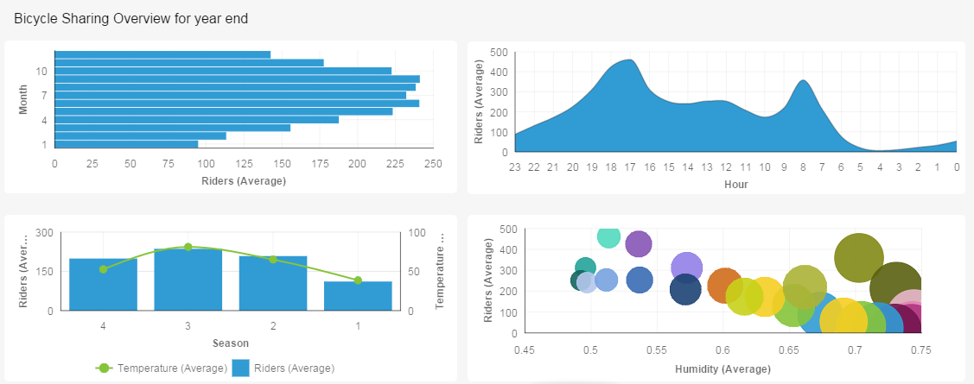
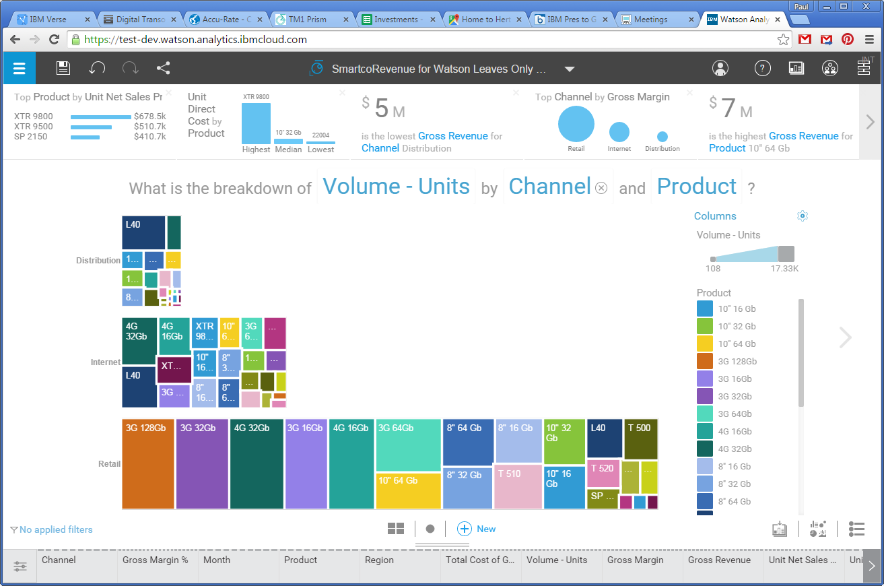
Data Discovery
Make data easy to explore, visualize and reveal insights with Watson Analytics
Natural language and guided discovery
Easy access to external data
Collaborate and share
Tell a story
Quickly gain insights to improve business performance and accuracy, and make better decisions with compelling visuals

Slide 11
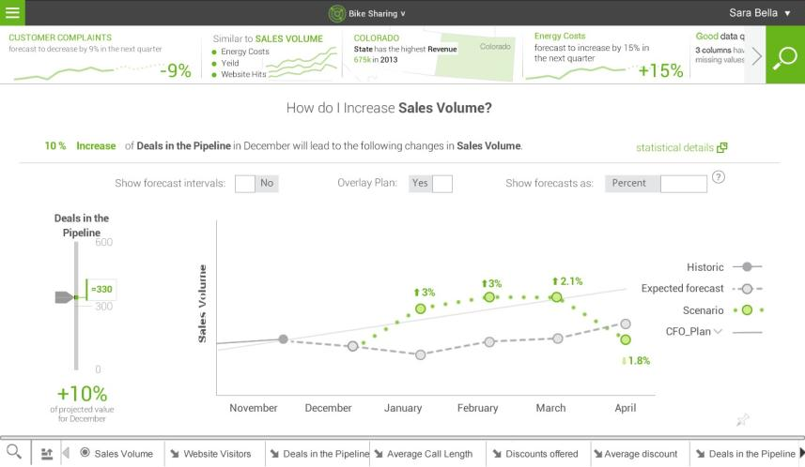
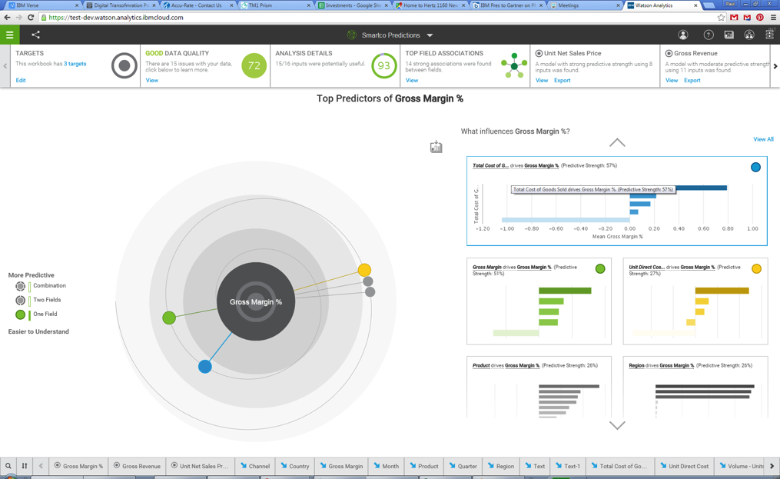
Advanced Analysis
Foresight | Make it easy for everyone determine drivers, infer trends and anticipate the future
Otomatik oluşturulmuş forecast
Farklı senaryoların karşılaştırılması
Performans metriklerinin belirlenmesi

Slide 12
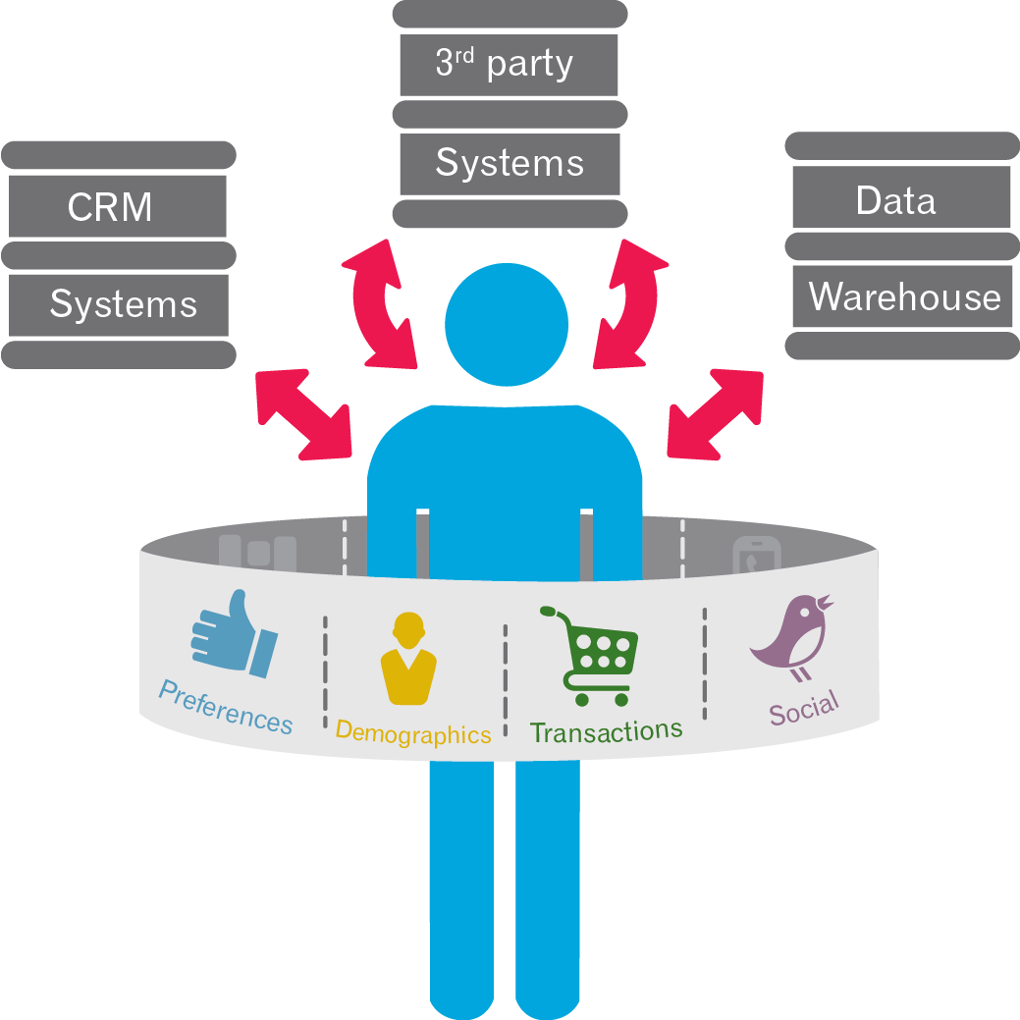
Internal and External Data
Integrated, Automated and Intelligent Data Integration
Ortamlar arası verilere güvenli erişimin etkin hale getirilmesi ( cloud ya da on-premise sistemler arasında )
Verileri, meta verileri ve güvenlik profillerinin performans yönetimi (FPM) veya iş zekası (BI) uygulamalarında kullanılmak üzere açık veri ambarlarına ve havuzlarına taşınması
Data synchronization, connectivity and transformation that enable you to orchestrate integration processes across multiple applications
Birden çok uygulama arasında entegrasyon , veri senkronizasyonu, bağlanabilirlik ve dönüştürme

Slide 13
IBM Planning Analytics Capabilities
Key Message | KEY CAPABILITIES
 | Planning & Analytics Workspace Excel Integration TM1 Engine
 | Data Discovery Advanced Analysis Internal & External Data
 | Strategy Management Metrics/Scorecards Management Reporting
SPEED
FORESIGHT
AGILITY

Slide 14
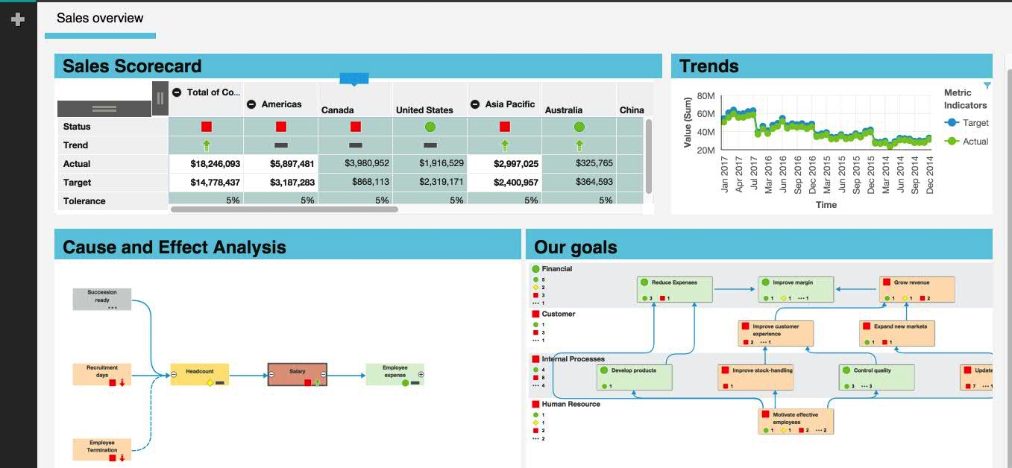
Strategy Management & Metrics/Scorecards
Alignment | Capture, communicate, monitor and assess business performance
Metrics & scorecards to monitor performance
Link strategy & execution

Slide 15
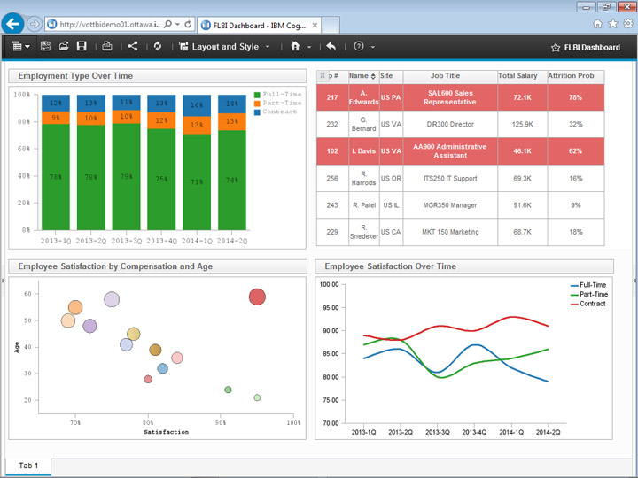
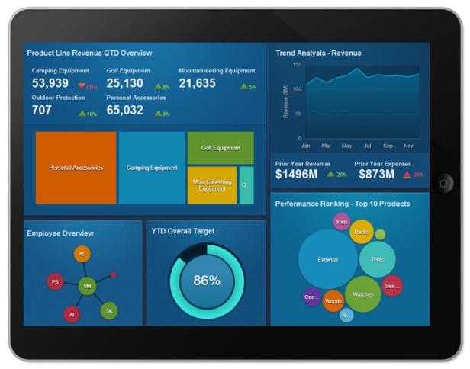
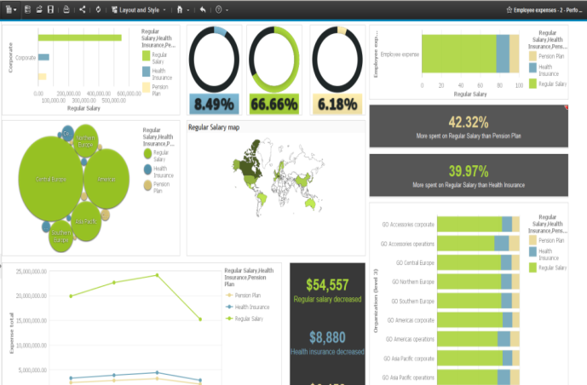
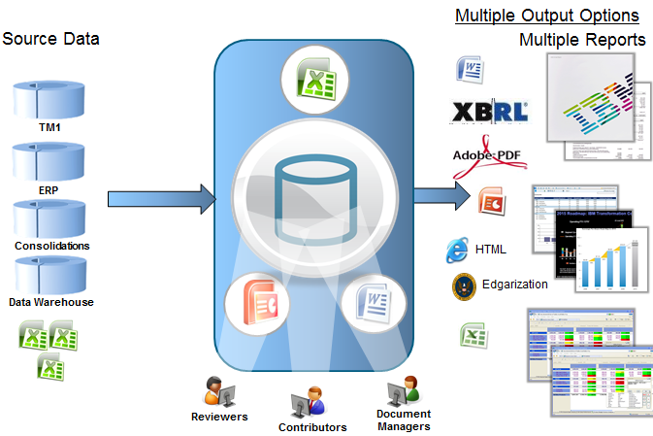
Management Reporting
Business Intelligence & Mobile | Self Service, Data Driven
Interactive Mobile reports anytime, anywhere
Business user self-service report design, consumption & sharing
Data Driven Narrative Reporting (PA Local only – certain PIDs)

Slide 16





IBM Planning Analytics
One Powerful Solution – 2 Deployment Options
Local On IBM Cloud
Or
Notes:
With this release we are delivering on our promise making cloud capabilities available to our on-Premise customers
We are focused on continuous delivery where we build first for the Cloud and then follow with the on-premise Local delivery
It’s much faster for us to deliver for the cloud first
We build for a single platform the IBM cloud and then
We can deliver on multiple other platforms for on-premise
The testing required to deliver across multiple Operating systems and databases take significantly more testing and certification
With our approach we are investing in a code base that serves multiple deployment options

Slide 17
IBM Planning Analytics Pricing
Cloud
Priced by Authorized User
Modeler
User
Explorer
Cognos Reporting now offered as a ‘Premium Reporting’ option
On-Premise
Multiple PIDs and methods to price (AU and PVU)
Analytic Server, PA Modeler, PA User, etc.
PA Advanced
Cognos PA Express
Different add-on products & functionality per Pricing Option
Pricing cheat sheets & pricing calculators found on FOPM Key Documents on Box
https://ibm.box.com/s/mu8d8zv11hu0a6w6706g0nqmx0009k1a

